Slide 1
Welcome to Network Security
EN.600.444/644
Fall 2019
Dr. Seth James Nielson

Slide 2





About the Instructor

Slide 3
About the Course
Network Protocol Stacks
PROGRAMMING
NETWORK SECURITY
Network architecture
Data Security
Cryptographic Protocols

Slide 4
Philosophical Overview
TECHNICAL
NON TECHNICAL
THEORY
PRACTICE
EDUCATED
SKILLED
TEACHER
STUDENT

Slide 5
The 5 Orders of Ignorance
0th Order: Known Knowns
1st Order: Known Unknowns
2nd Order: Unknown Unknowns
3rd Order: Unknown methods for discovering unknown unknowns
4th Order: Unknown methods for exploring the orders of ignorance
(Adapted from Phillip Armour, “The Five Orders of Ignorance”)

Slide 6
The 5 Orders of Ignorance
0th Order: Known Knowns
1st Order: Known Unknowns
2nd Order: Unknown Unknowns
3rd Order: Unknown methods for discovering unknown unknowns
4th Order: Unknown methods for exploring the orders of ignorance
(Adapted from Phillip Armour, “The Five Orders of Ignorance”)
SKILL
EDUCATION

Slide 7

Student + Teacher
MEDIOCRITY
Sufficient Time
Sufficient Sacrifice
Sufficient Humility
SHARED VISION

Slide 8
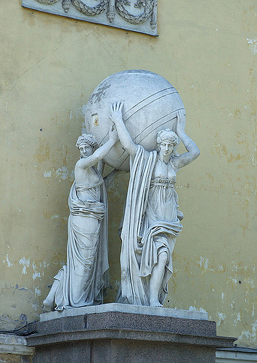
Your Burden
Programming Exercises
LAB 1: Reliable Delivery
Draft Specifications
LAB 2: Secure Delivery
This Photo by Unknown Author is licensed under CC BY-SA-NC

Slide 9
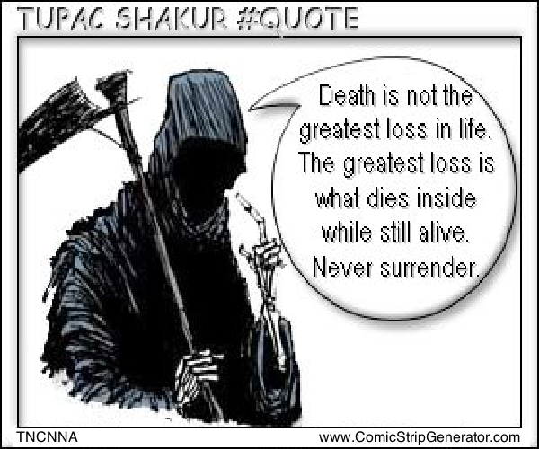
But You CAN Do It!
I BELIEVE in YOU
I want you to SUCCEED!
I want you to feel the RUSH and LOVE it!
This Photo by Unknown Author is licensed under CC BY-NC-ND

Slide 10
But Understand the Risks
A “B” (or maybe even a “C”) is not the greatest loss in your academic career. The greatest loss is an “A“ on your transcript, but a “B“ (or maybe even a “C”) in your heart and mind.
Dr Nielson #Quote

Slide 11
This Class is NOT for You If…
Grades matter more than learning
You’re not willing to take risks
You’re not willing to work hard
You’re not willing to be uncomfortable

Slide 12
This Class IS For You If…
You want to increase your awesomeness
You want to think in ways you’ve never thought before
You like taking on challenges
You understand both figuring things out for yourself and the need to get help

